Slide 1
Neuroanatomy
GP-1 section 1.1 Neuro anatomy normal nervous system and structural organization of the brain and the spinal cord, peripheric and autonomous nervous system
Pille Taba
Ülle Krikmann
Tartu University

Slide 2
Aims of the lecture
By the end of this lecture the student should be able to understand and explain
Development of the nervous system
structural organization of the nervous system
Anatomy of the nervous system

Slide 3
Content of lecture
Fetal development of nervous system
Developmental disordes
Elements of nervous system
Chemical neurotransmitters
Structure of nervous system
Anatomy of nervous system

Slide 4
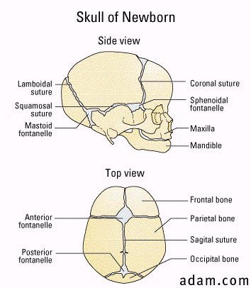
Development of nervous system
Brain of newborn - 350-400 g (10% of body weight)
At of 1 year of age - 1000 g
Adult - 1200-1400 g (2% of body weight)
Spinal cord - 2% of brain’s weight
Dysontogenesis – disorder of development
Genetic factors (eg trisomia of 21st chromosome – Down disease)
Infections during the fetal period: syphilis, ttuberculosis, toxoplasmosis, viral infections
Toxic factors: medictions, alcohol, smoking

Slide 5
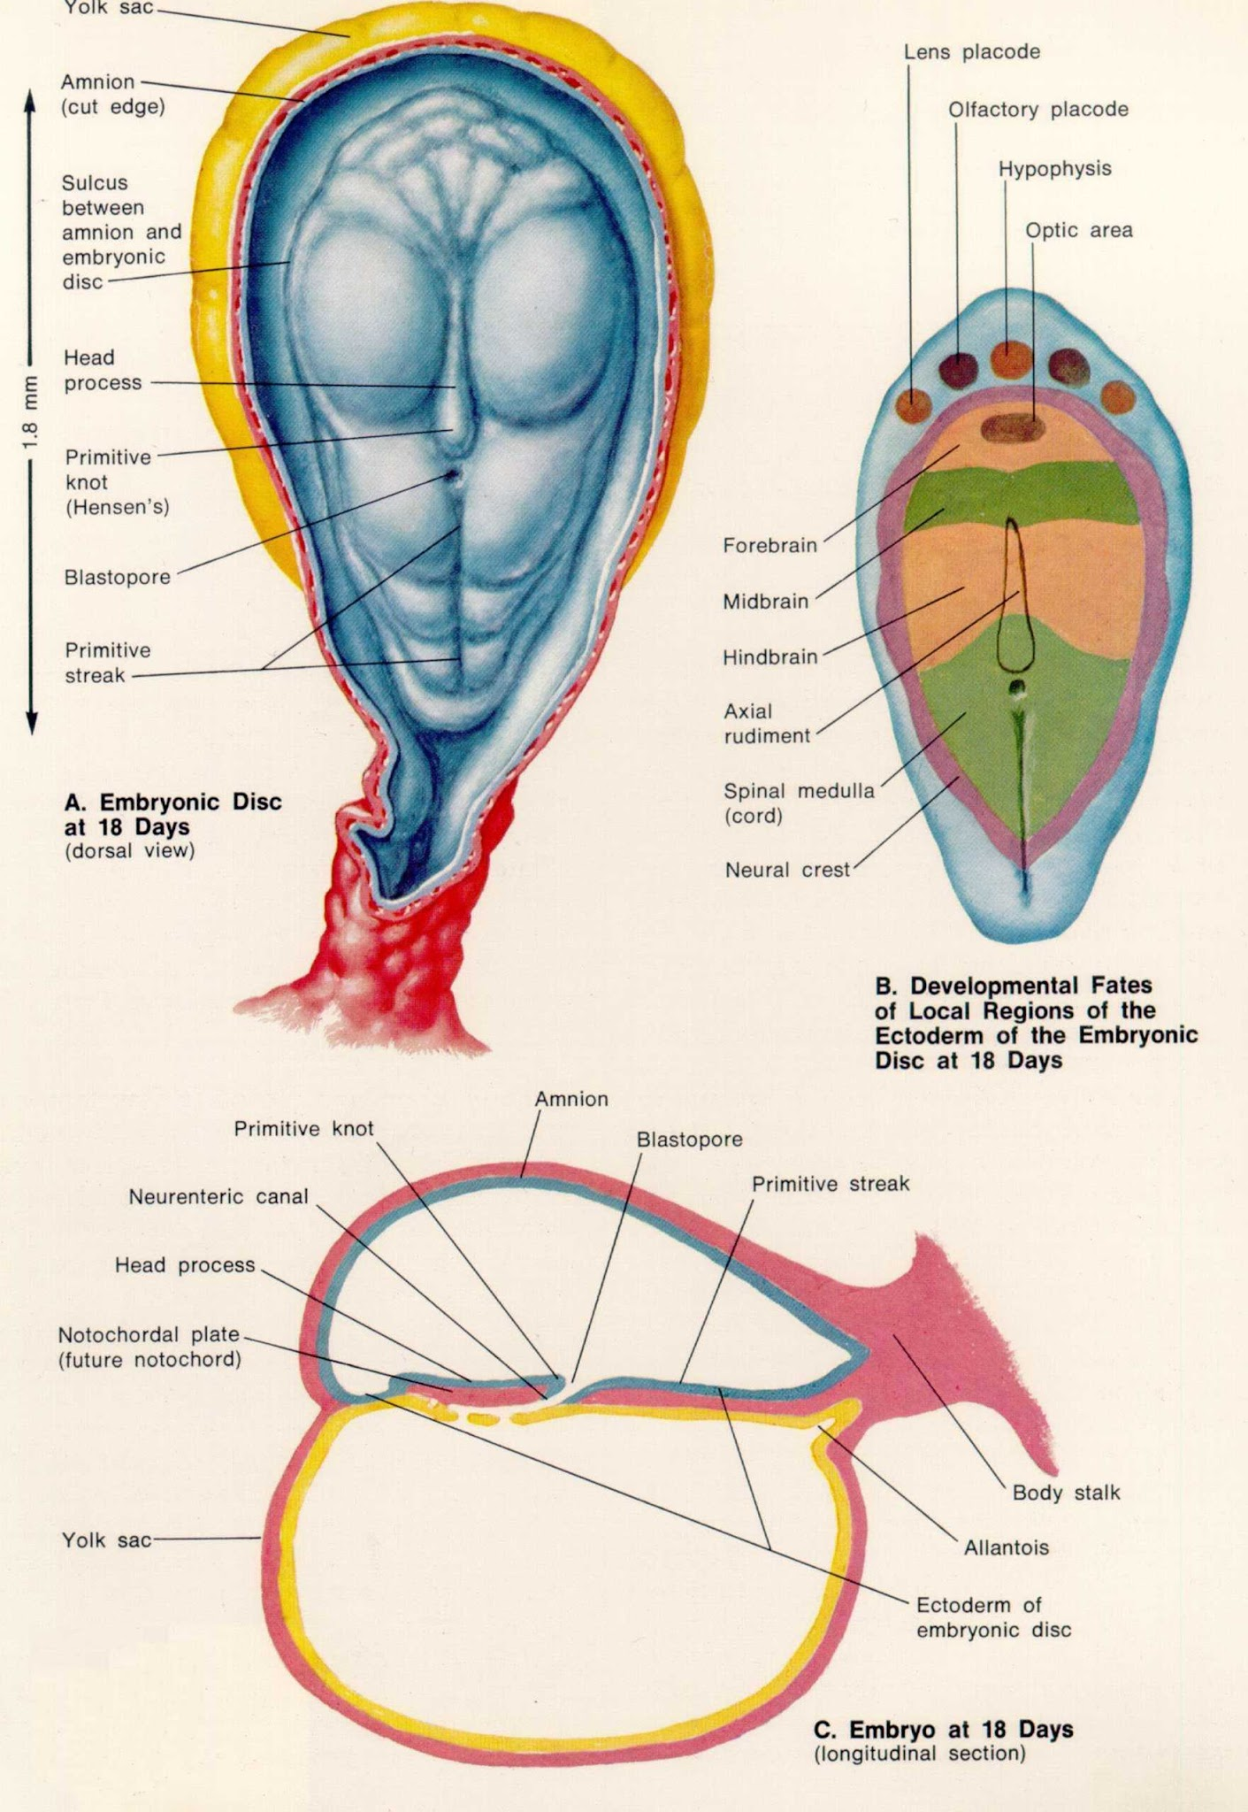
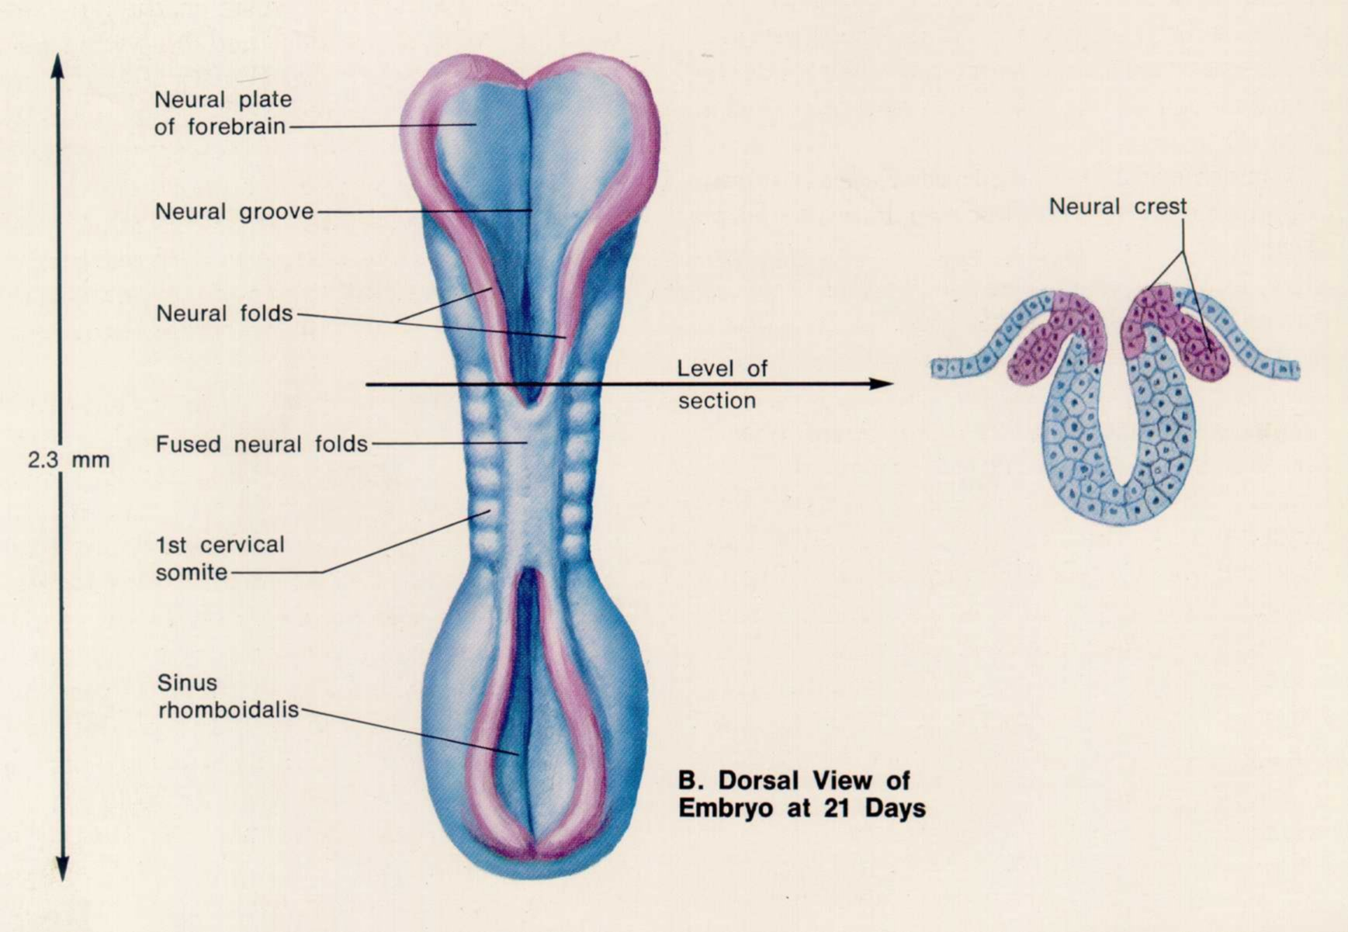
Development of nervous system I
21-28 fetal days:
Neural tube; diffrentiation:
Cranial part
Caudal part
18 days: development of
ectoderm → nervous system
mesoderm
endoterm
Early developmental disorders

Slide 6
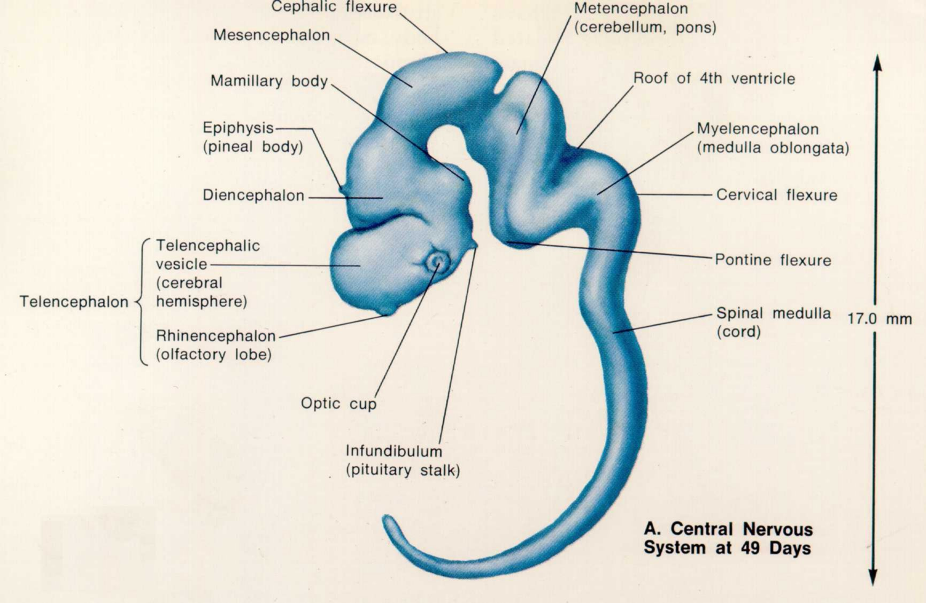
Development of nervous system II
36-49 fetal days
Differentiation of teleancephalon
Development of primary ventricle system
3 fetal months
Balanced proportions of brain parts
Cerebellum, pons
Lateral sulcus between frontal and parietal lobes
Differences from adult brain:
No structured sulci and gyri
Extension of spinal cord until coccygeal part of vertebrae (in adult: until first lumbal vertebrae)

Slide 7
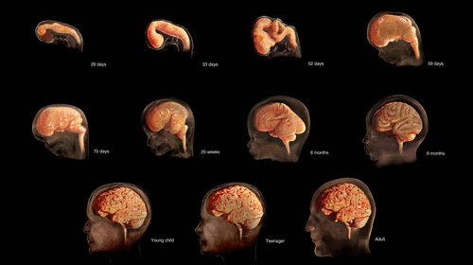
Development of nervous system III
6 fetal months
Normal brain structurs: gyri and sulci
Obliteration of subarachnoid space
All neurons and glial cells existing
Further developments:
Synapses
Myelination
Dendritic connections
The process that will ultimately give rise to the connectome begins about 25 days after conception, when the neural tube begins to form. By the end of the embryonic period (gestational week 10), the basics of the neural system are established. All the structures continue to develop throughout the fetal period and early childhood. By 6 years of age, the brain has reached 90% of its adult volume. By age 25, it typically is fully developed. Image: © TheVisualMD/Science Source.

Slide 8
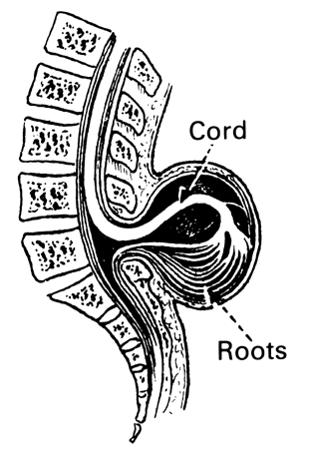
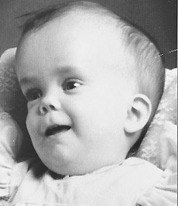
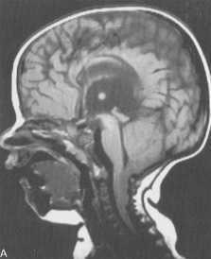
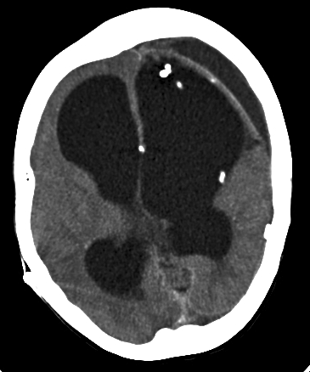
Dysontogenesis – developmental disorders
Hydrocephalia
Encephalocele
Meningoradiculocele
Craniosynostosis
Infections
Toxic factors
Genetics
Craniovertebral disorders:
Arnolc-Chiari syndrome

Slide 9
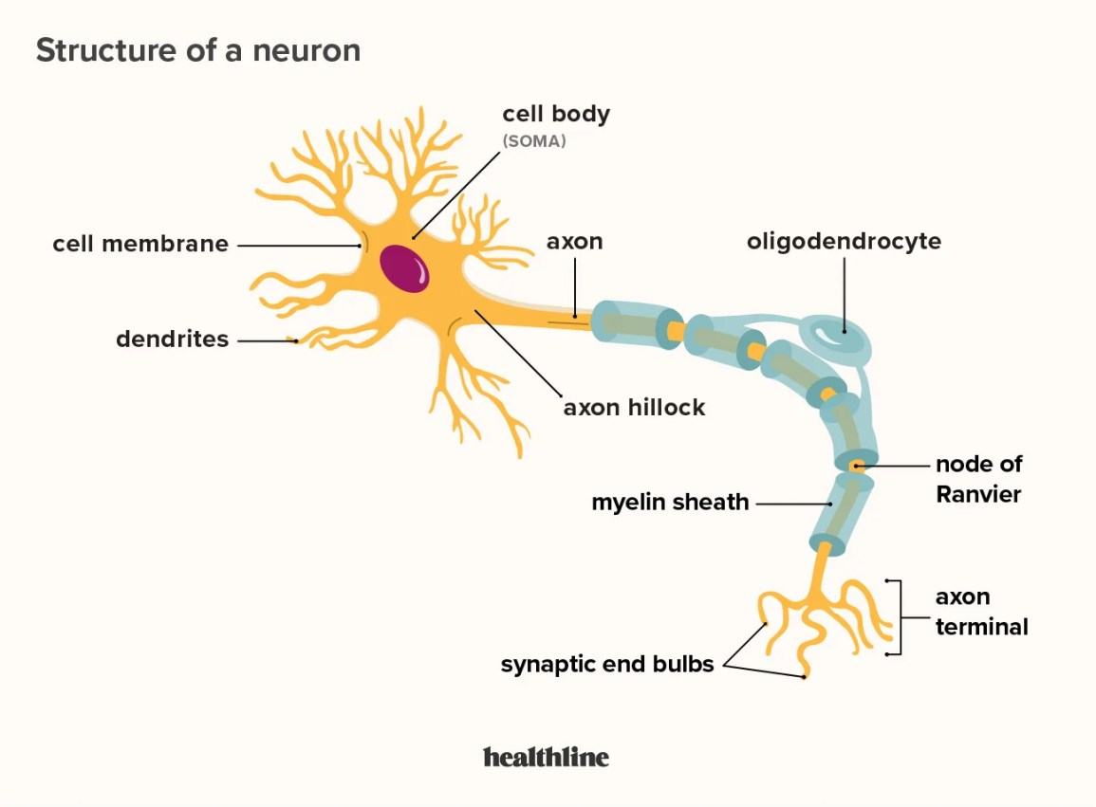
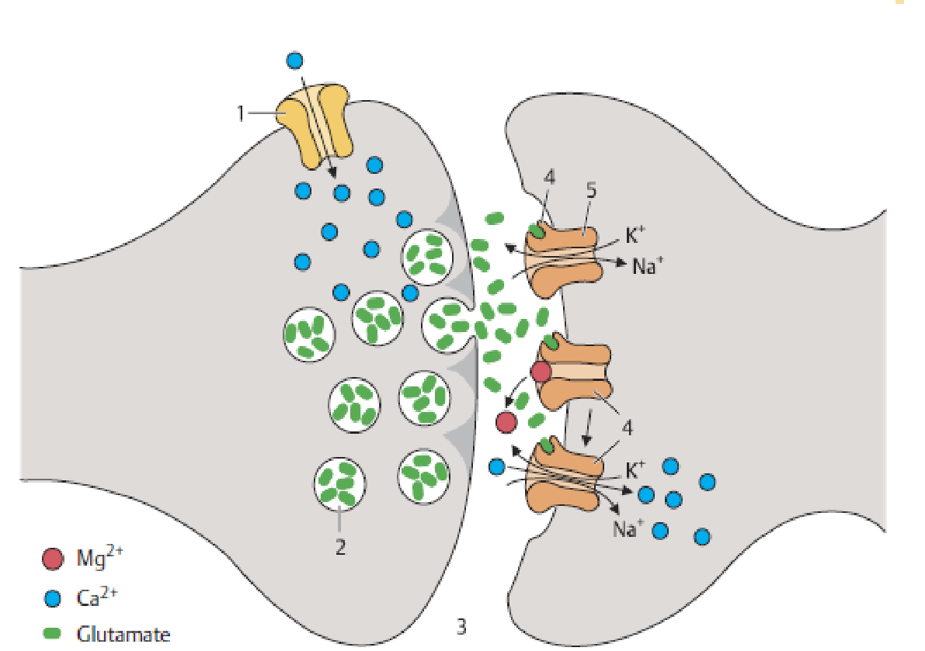
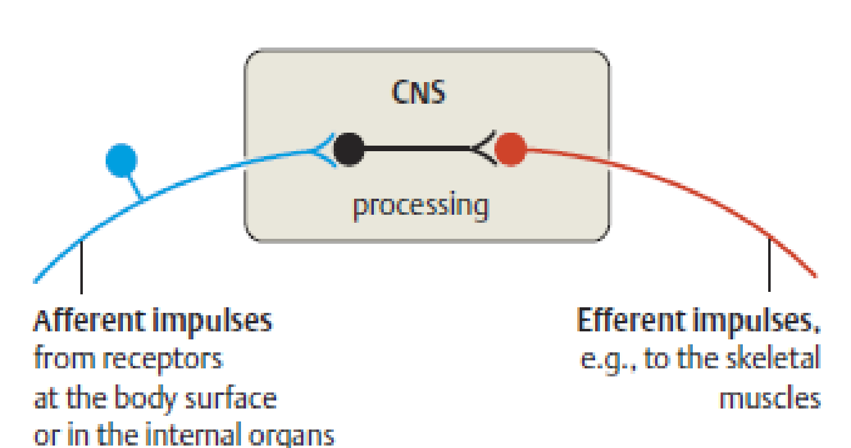
Elements of the nervous system
Neuron - specialized for information processing and transmission
Synapse – a junction withwhom the neurons make contact with each ohter
Neurotransmitter - chemical messenger substance
Information flow
afferent impulses - from receptors at the body surface or in the internal organs to CNS
efferent impulses – from CNS to the skeletal muscles etc

Slide 10
Neurons and glia cells
Neurons transfer information only one directions
Dendrite – short, act to receive impulses from other neurons, conducting the electrical signal towards the nerve cell body.
Axon - long, transmission to conduct impulses away from the neuronal body
Glial cells - non-excitatory cells that support neurons
Glial cell

Slide 11
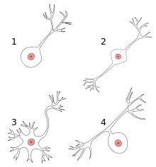
Neurons types and structure
Unipolar (1). Single process
Bipolar (2): 1 axon, 1 dendriite - retina
Multipolar (3): 1 axon, multiple dendrites – pyramidal cells, Purkinje cells, motoneurons in spinal cord
Pseudounipolar (4): 1 process which then serves as both an axon and a dendriite – sensory ganglion

Slide 12
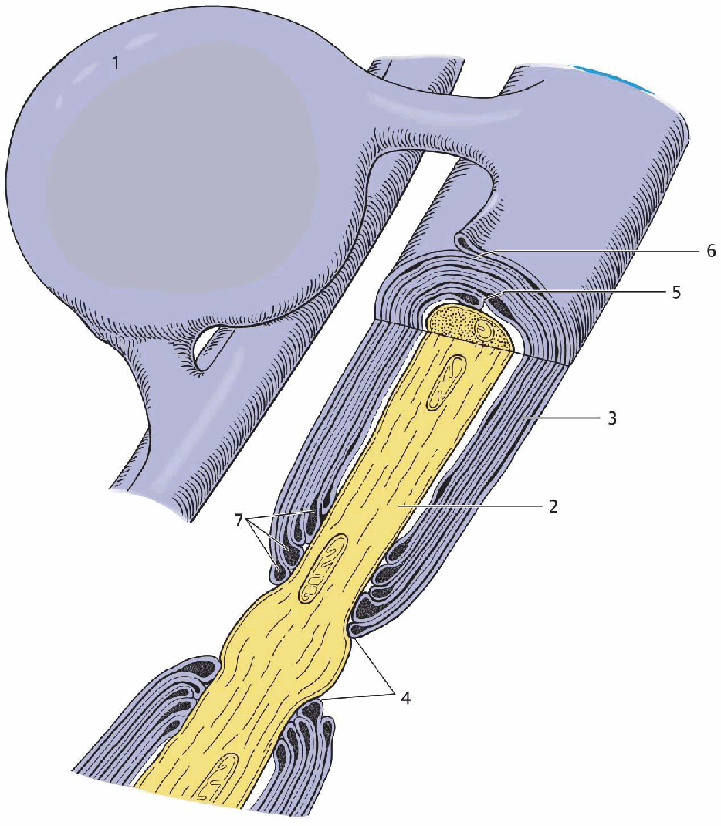
Glia cells
Occur in central and peripheral nervous system
form myelin sheaths around neurons, nerve fiber
provide nutritional, ionic, mechanical support to neurons
may regulate neural shape and synaptic connectivity
microglia: phagocytes
macroglia:
Astrocytes (astroglia) - CNS
Oligodendrocytes (oligodendroglia) - CNS
Shwann cells - PNS
Fig. 1.4 Nerve fiber in the central nervous system, with oligodendrocyte and myelin sheath
(schematic drawing). 1, Oligodendrocyte. 2, Axon. 3, Myelin sheath. 4, Node of Ranvier. 5, Inner
mesaxon. 6, Outer mesaxon. 7, Pockets of cytoplasm. From: KahleWand Frotscher M: Taschenatlas
der Anatomie, vol. 3, 8th ed., Thieme, Stuttgart, 2002.

Slide 13
Neural information transmission
Nerves transmit info as electrical signals
Myelin is wrapped around axons as a layer of insulation
Myelin sheath allows electrical messages to travel faster:
thickly myelinated: A fibers are of 320 μm diameter and conduct at speeds up to 120 m/s
thinly myelinated: up to 3 μm thick and conduct at speeds up to 15 m/s
unmyelinated: no faster than 2 m/s.

Slide 14
Synapse
The junction with the neuron pass an electrical or chemical signal to another neuron
Each individuaal neuron receives information through synapses from many different neurons and neuron types
The axon ends on oneside of the synapse, and neural impulses are conveyed across it by special transmitter substances
The axon terminal (bouton) is the presynaptic part of the synapse, and the membrane of the cell receiving the transmitted information is the postsynaptic part.
The presynaptic and postsynaptic membranes are separated by the synaptic cleft.
The bouton contains vesicles filled with the neurotransmitter substance.
Fig. 1.6 Synaptic transmission at a glutamatergic (excitatory) synapse (schematic drawing). The
arriving action potential induces an influx of Ca2+ (1), which, in turn, causes the synaptic vesicles (2)
to fuse with the presynaptic membrane, resulting in the release of neurotransmitter (in this case,
glutamate) into the synaptic cleft (3). The neurotransmitter molecules then diffuse across the cleft
to the specific receptors in the postsynaptic membrane (4) and bind to them, causing ion channels
(5) to open, in this case Na+ channels. The resulting Na+ influx, accompanied by a Ca2+ influx, causes
an excitatory depolarization of the postsynaptic neuron (excitatory postsynaptic potential, EPSP).
This depolarization also removes a blockade of the so-called NMDA receptor by Mg2+ ions. From:
Kahle W and Frotscher M: Taschenatlas der Anatomie, vol. 3, 8th ed., Thieme, Stuttgart, 2002.

Slide 15
Neuron basic functions
The neuron is electrically discharging and transmitting information via synapses to other neurons. Excitatory input to the neuron causes it to discharge
The neuron is silent caused by inhibitory input
Excitatory neurons are usually principal neurons (e. g., the pyramidal cells of the cerebral cortex), which often project over long distances and thus have lõng axons.
Inhibitory neurons, on the other hand, are often interneurons and have short axons.
Collaterals of excitatory cells can activate inhibitory interneurons, which then inhibit the principal neuron itself – recurrent inhibition, negative feedback
Collaterals of principal neurons activate inhibitory interneurons that then inhibit other principal neurons - forward inhibition

Slide 16
Structure of nervous system
Nervous system are actually interconnected with each other.
Axon bundles pass impulses between the brain and spinal cord. These bundles within the CNS are called afferent and efferent neural pathways or tracts.
Axons that extend from the CNS to connect with peripheral tissues belong to the PNS. Axons bundles within the PNS are called afferent and efferent peripheral nerves.
Functionally the PNS is dividing to
somatic nervous system (SNS) - as the voluntary system
Autonomic nervous system (ANS) - described as the involuntary system.
Central nervous system (CNS)
Brain
Spinal cord
Peripheral nervous system (PNS)
Peripheral nerves: cranial nerves, spinal nerves
Ganglia
Autonomic nervous system (ANS)
Parasympathetic
Sympathetic

Slide 17
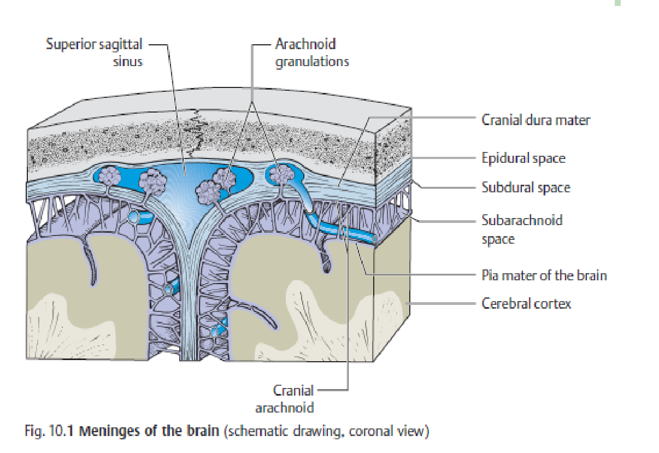
Anatomy of central nervous system
Three membranes cover spinal cord and brain:
Dura mater – tough, fibrous coat
Arachnoid mater – fragile, impermeable layer
Pia mater – highly vascularized membraane
The dura mater is innervated by branches of trigeminal nerve, the infratentorial part by upper cervical segmentaal nerves and the vagus nerve,
Some of the dural nerves are myelinated while others are unmyeliniated. The endings respond stretch, it is often painful
The afferent fibres accompanying the meningeal arteries are particularly sensitiive to pain
The space between the arachnoid and pia mater contains cerebrospinal fluid (CSF)
Clinical case: meningeal syndrome with severe headache, nausea, vomiting and neck rigidity, opistotonus caused by infections, subarachnoidal hemorrhage
Cerebrospinal fluid

Slide 18
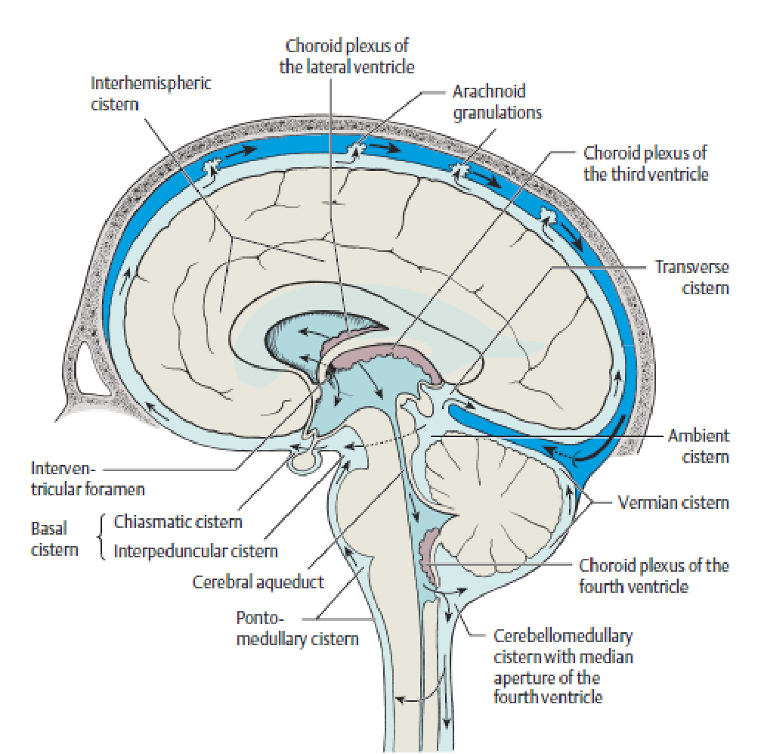
Ventricular system
Consist of two lateral ventricles, third ventricle, fourth ventricle
Lateral ventricles are connected with third ventricle through the interventricular foramina (foramina Monro)
Third ventricle communicate via cerebral aqueduct with fourth ventricle
The fourth ventricle empties into the subarachnoidal space via foramen Magendie (single mediaan aperture) and the foramina Luschka (paired lateral apertures)
Lateral ventricle
Third ventricle
Fourth ventricle
Circulation of the CSF

Slide 19
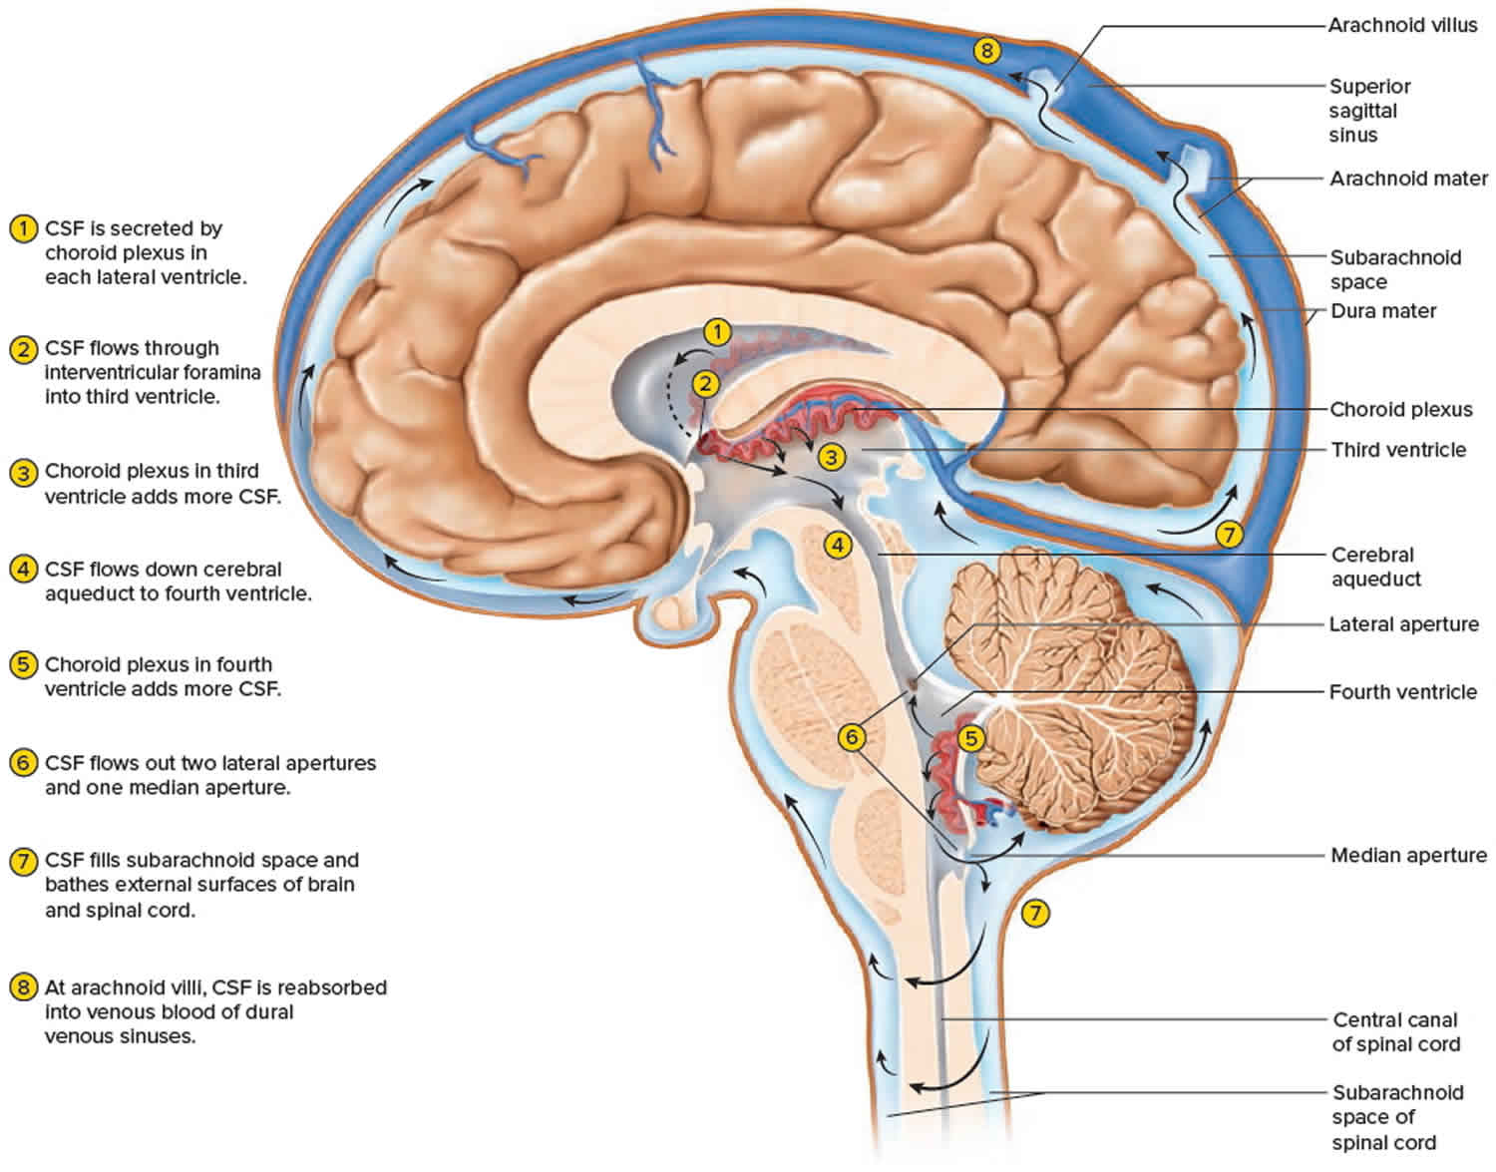
Cerebrospinal fluid
It is actively secreted in choroid plexus
Circulaating CSF volume is about 90 – 200 ml, ca 20% is in lateral ventricles
CSF volume is exchanged 3 or 4 times daily
CSF produced about 20 ml/per hour
Normal pressure is keskmiselt 15 cmH₂O (6-25 cmH₂O) in supine position
Blood within capillaries of the choroid plexus is separated from the subarachnoid spaceby the blood-CSF barrier (vascular endothelium, basal mebrane, plexus epithelium

Slide 20
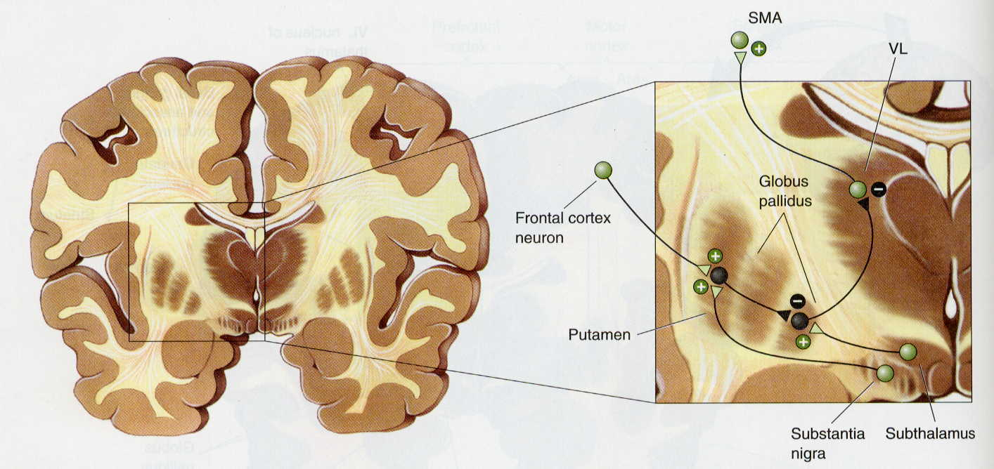
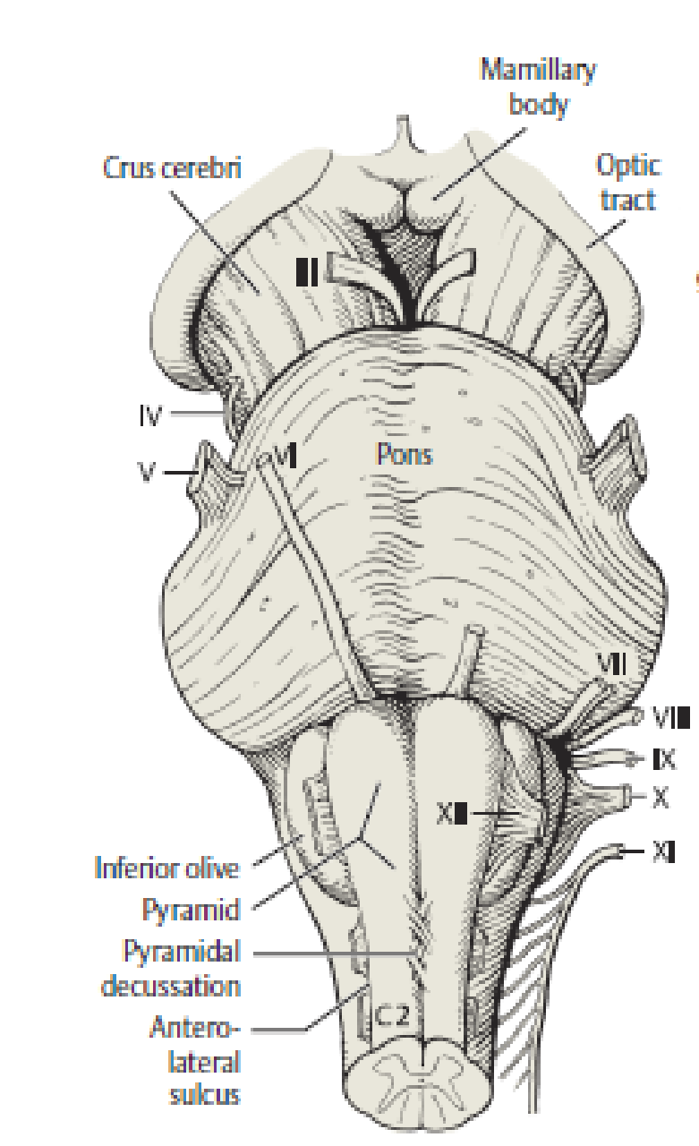
Anatomy of brain
Cerebrum – telencepfalon, diencephalin
Telencephalon
cerebral hemispheres: gray matter (neurons) – cerebral cortex, basal nuclei
white matter – axons, tracts
Lateral ventricles
Diencephalon
Third ventricle
Thalamus
Mamillary bodies
Hypothalamus
Optic chiasm
Tuber cinereum

Slide 21
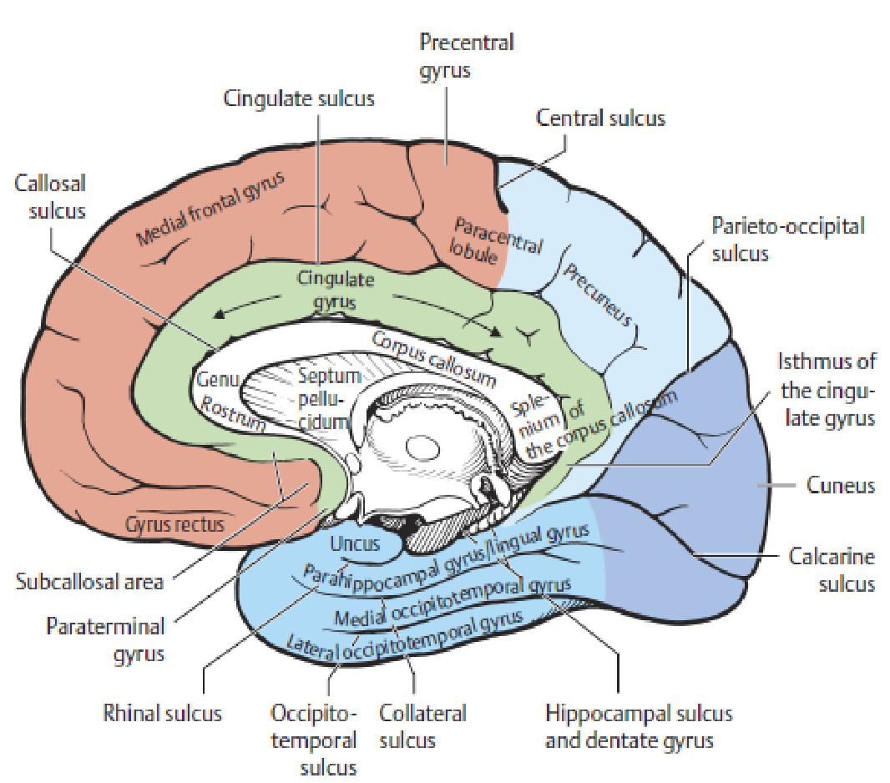
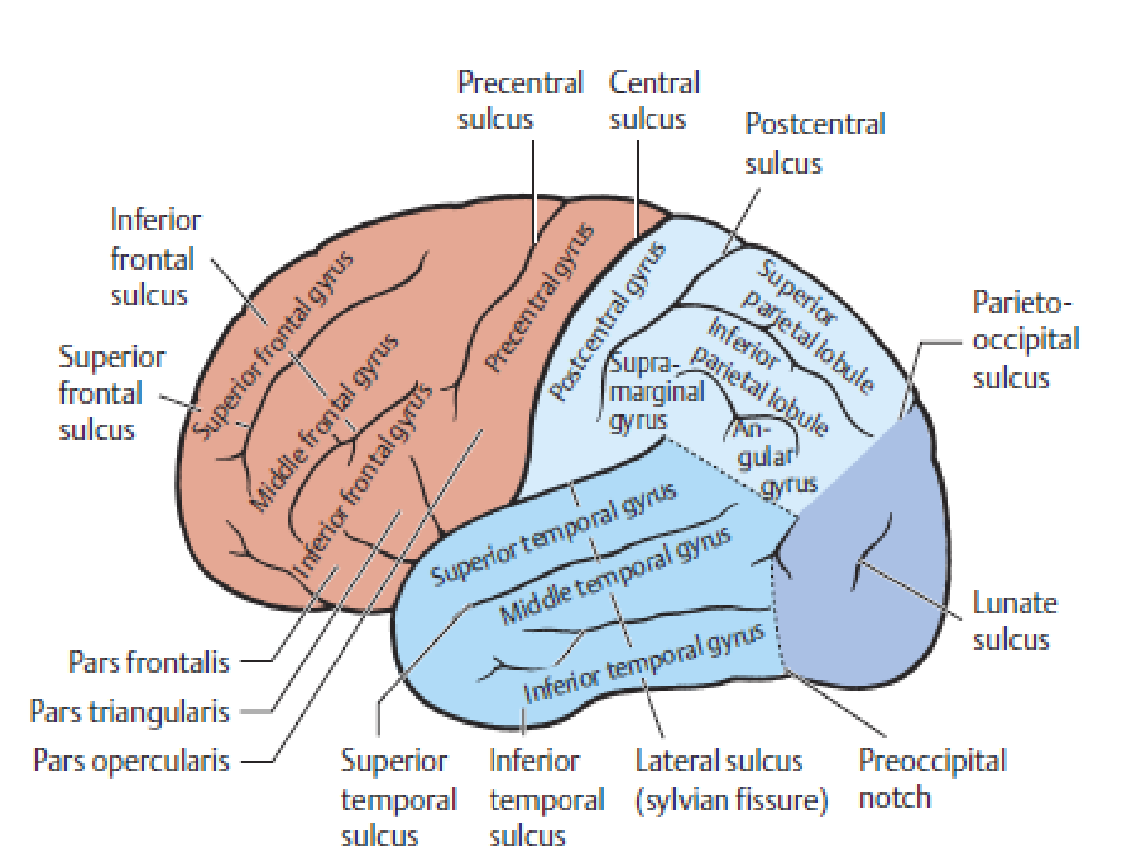
Brain surface
Medial surface

Slide 22
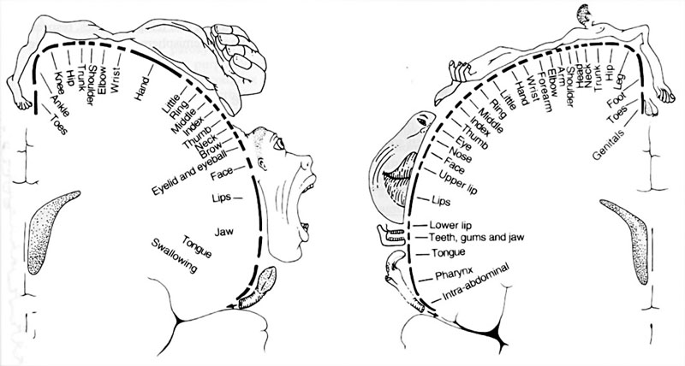
Gyrus precentralis – motor area Gyrus postcentralis – sensory area

Slide 23
Movements
Human moving is vital for his life
The body is designed to move in all directions
The human can walk, run, jump, swim, bend forward, backwards and so on
All moving is directed by the motor system of the nervous system

Slide 24
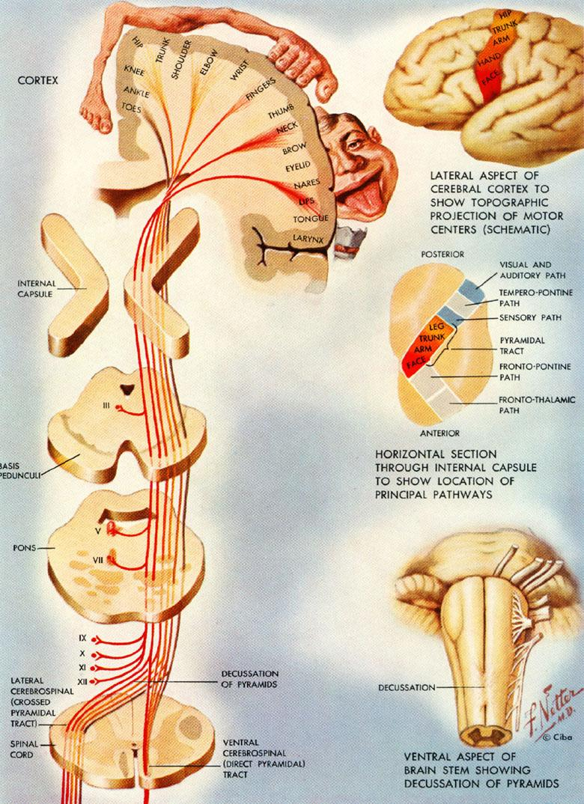
Motor system I
Anatomical and functional substrates of motor system:
Central motor neuron: Cortex (neurons in the gyrus precentralis)
Corticospinal tract – main neuronal pathway (white matter) for voluntary motor functions between precentralis cortex and motor neurons in spinal cord
Corticobulbar tract – neuronal pathway for movements of cranial nerves.
85% pyramidal fibres cross in brainstem
Lateral corticospinal tract (crossed)
Anterior corticospinal tract (not crossed)
Clinical note:
limb weakness – spastic paresis

Slide 25
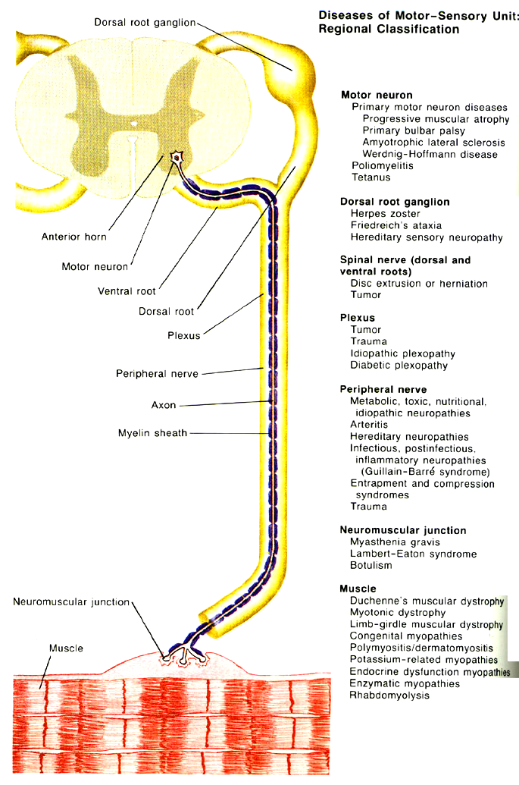
Motor system II
Peripheral motor neuron: neurons in the anterior horn (grey matter)
Anterior root
Nerve plexus
Peripheral nerve
Motor end plates of
neuromuscular junction
Clinical note:
limb weakness –flaccid paresis

Slide 26
Motor regulation systems
To move smooth, precise and economical execution
Integrate proprioceptive input from the peripheral nerves, posterior columns, thalamus, thalamocortical pathways, further input from the vestibular apparatus and visual system, use feedback data to optimize allmovement at every moment
Plan the force and amplitude of the movement
Coordinate the activity of all of the muscles taking part in a movement
Clinical note:
Ataxia – repeated deviation from the idealline movement
Hypokinesia – generalized slowing of all movements
Involuntary movements

Slide 27
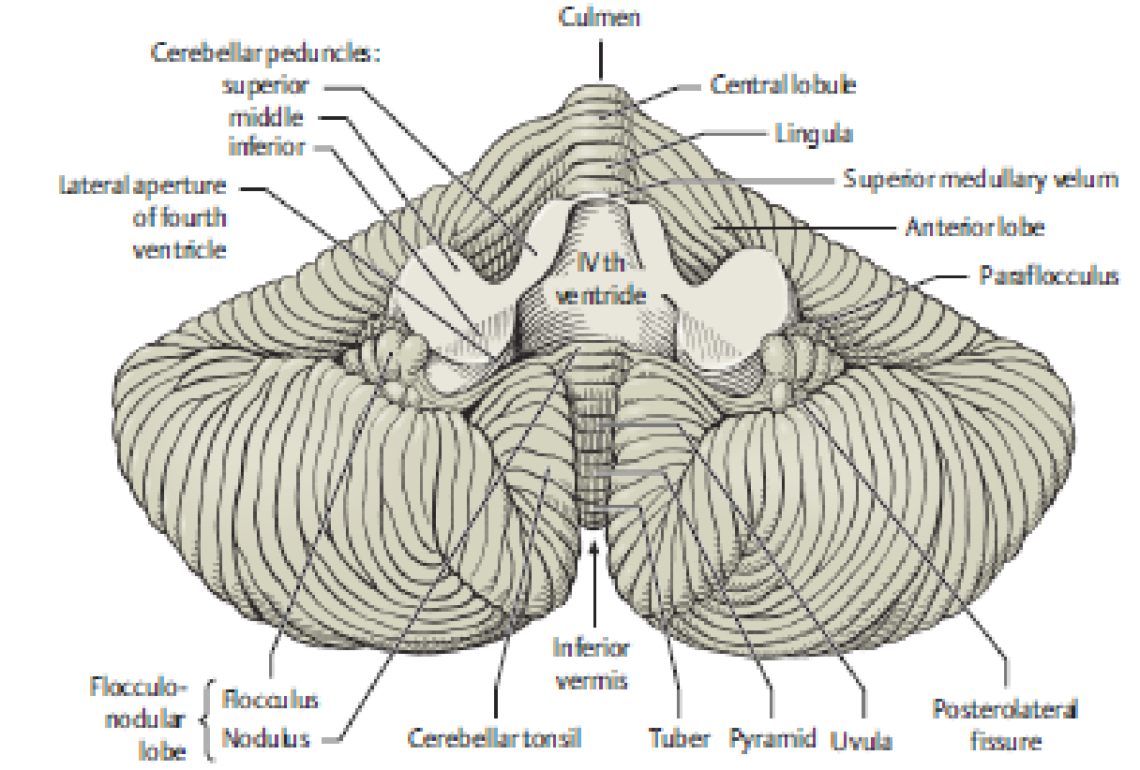
Cerebellum
Fine motor control
receives a very large amount of general and special sensory input (particulary vestibular and proprioseptive), together with motor impulses
Modulate the activity of motor nuclear areas in the brain and spinal cord
Anatomically is made up of two hemispheres and the vermis that lies between them.
Connection to the brainstem by three cerebellar peduncles
Cerebellar cortex is primarily responsible for the integration and processing of afferent impulses

Slide 28
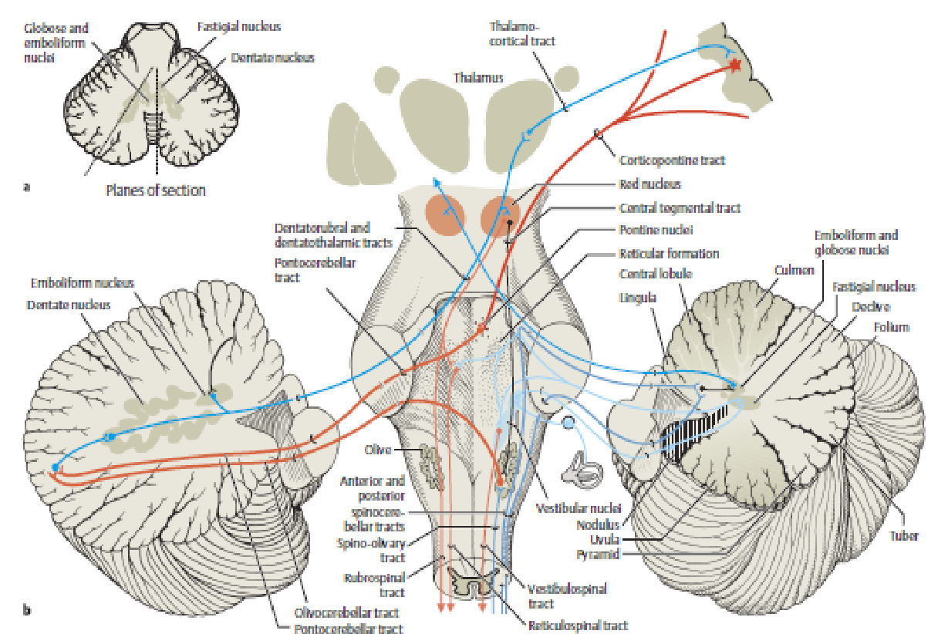
Afferent and efferent connections with cerebellum
The vestibulocerebellum receives impulses from the vestibular apparatus carrying information about the position and movements of the head
The spinocerebellum controls muscle tone and coordinates the actions of antagonistic muscle groups that participate in stance and gait. Its efferent output affects the activity of the anti-gravity muscles controls the strength of forces induced by movement
The neocerebellum enable to regulate all directed movements smoothly and precisely.

Slide 29
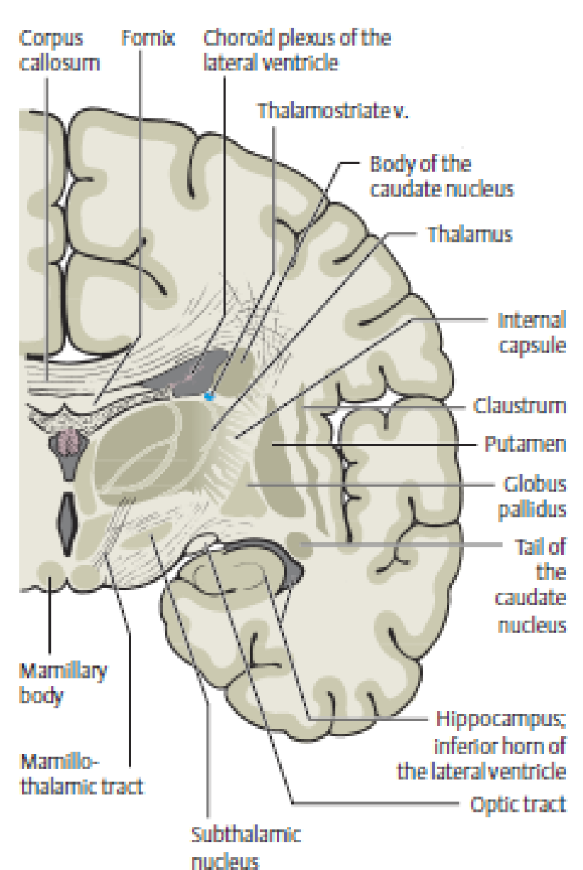
Basal ganglion system
A part of the motor regulation system where the subcortical nuclei are connected to each ohter, and to the motor cortex
The system exert both excitatory and inhibitory effects on the motor cortex
The role of the movement is the initiation, modulation of movement and control of muscle tone

Slide 30
Somatosensory system
a network of neurons to recognize objects, discriminate textures, generate sensory-motor feedback and exchange social cues
Anatomical substrates
Receptors convert information into electical action potential
Specialised: smell, vision, hearing
Visceral: viscera, smooth muscle (unconscious or autonomic)
Somatic: skin, striated muacle, joints

Slide 31
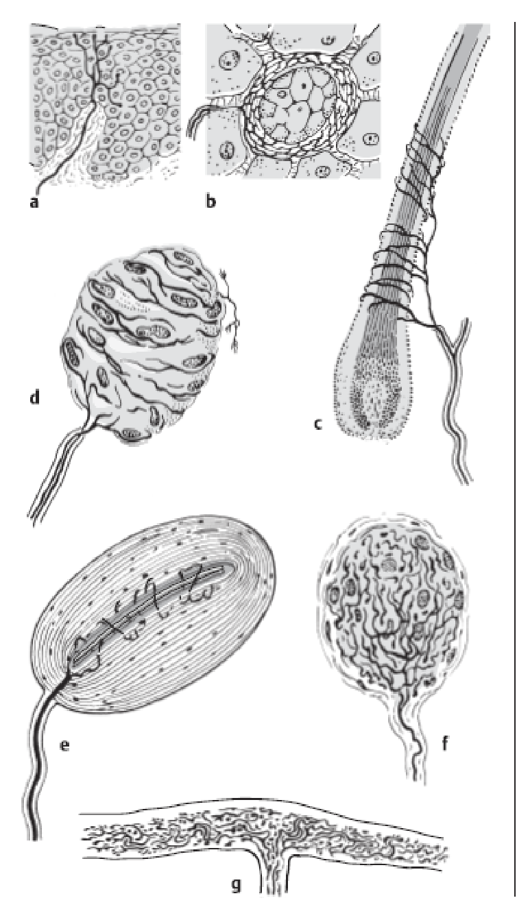
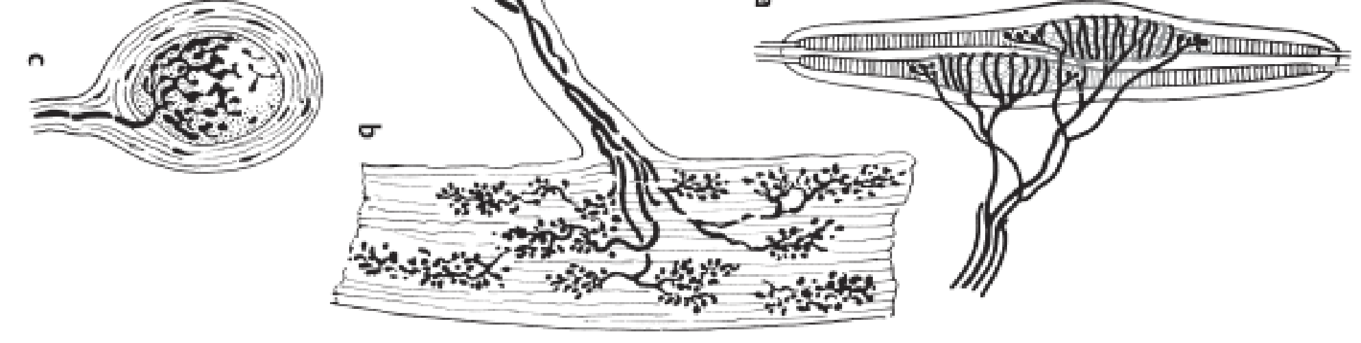
Skin receptors
e
g
Skin receptor types
Pressure – Pacinian (a);
Cold – Krause (b)
Warmth – Ruffini (c)
Light touch – Meissner (d)
Pain - free nerve ending (e)
Touch - hair follicle (f)
Tactile disk - Merkel (g)
Muscle and tendon receptors
Muscle spindle – strech (i)
Golgi tendon organ –tension (j)
Golgi-Mazzoni corpuscle –pressure (k)
d
f
b
a
c
j
k
i

Slide 32
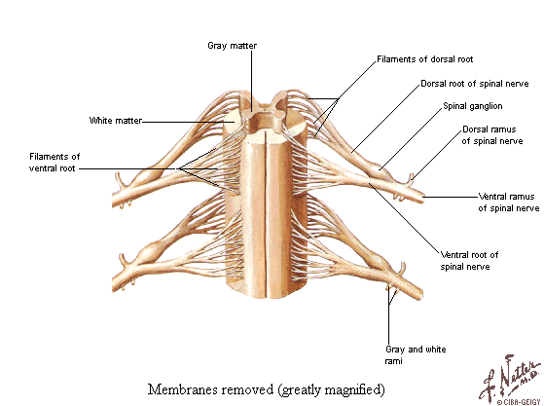
Somatosensensory system – central connections
Afferent sensory fibres run in the peripheral nerves, plexuses, posterior spinal nerve roots – axon of the sensory neuron
Sensory neurons are bipolar neurons – spinal ganglion
Individual sensory fibres enter the spinal cord via dorsal root entry then give off collaterals
Different sensory modalities occupy in different positions in the spinal cord

Slide 33
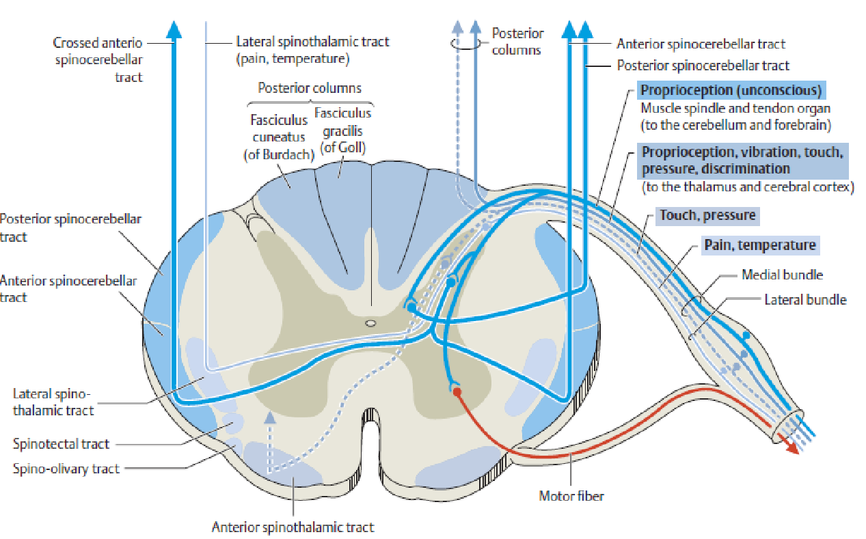
Somatosensory modalities in spinal cord
Spinothalamic pathway: pain, temperature, simple touch
Dorsal column pathway: discriminating touch (texture, contour, size, shape), proprioception – muscle and tendon receptors
Dorsal and ventral spinocerebellar pathway - proprioception

Slide 34
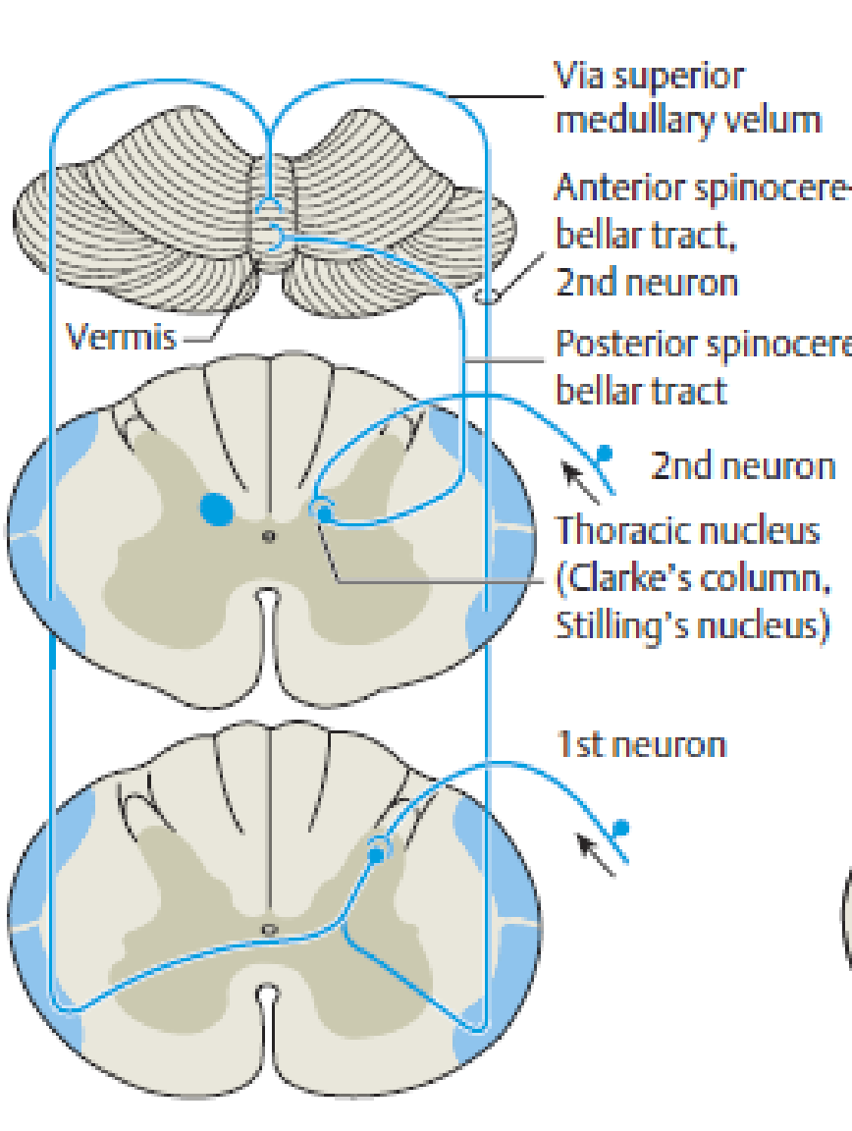
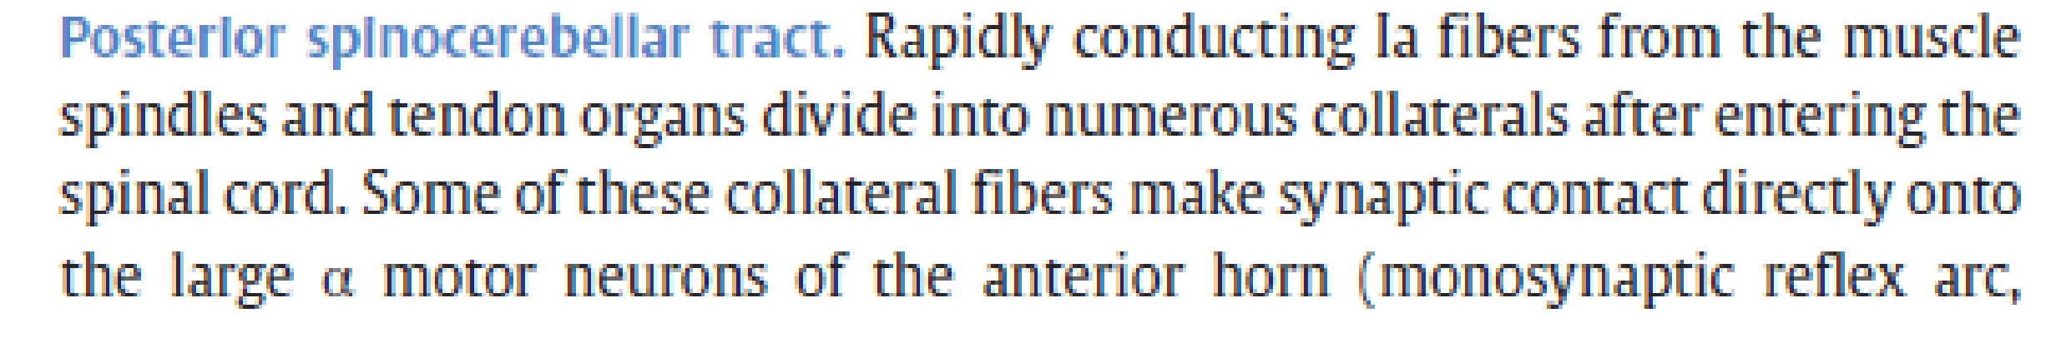
Anterior and posterior spinocerebellar tracts
Anterior spinocerebellar tract – ascends the spinal cord both ipsilaterlally and contralaterally, transverses the floor of the IV ventricle to the midbrain and reach the cerebellar vermis
Posterior spinocerebellar tract – ascends the cord ipsilaterally in the lateral funiculus and travels by of the inferior cerebellar peduncle to the cerebellar vermis
Most rapidly connecting fibres
„unconscious“ proprioception with hepl polysynaptic efferent output influence muscle tone, coordinated actions

Slide 35
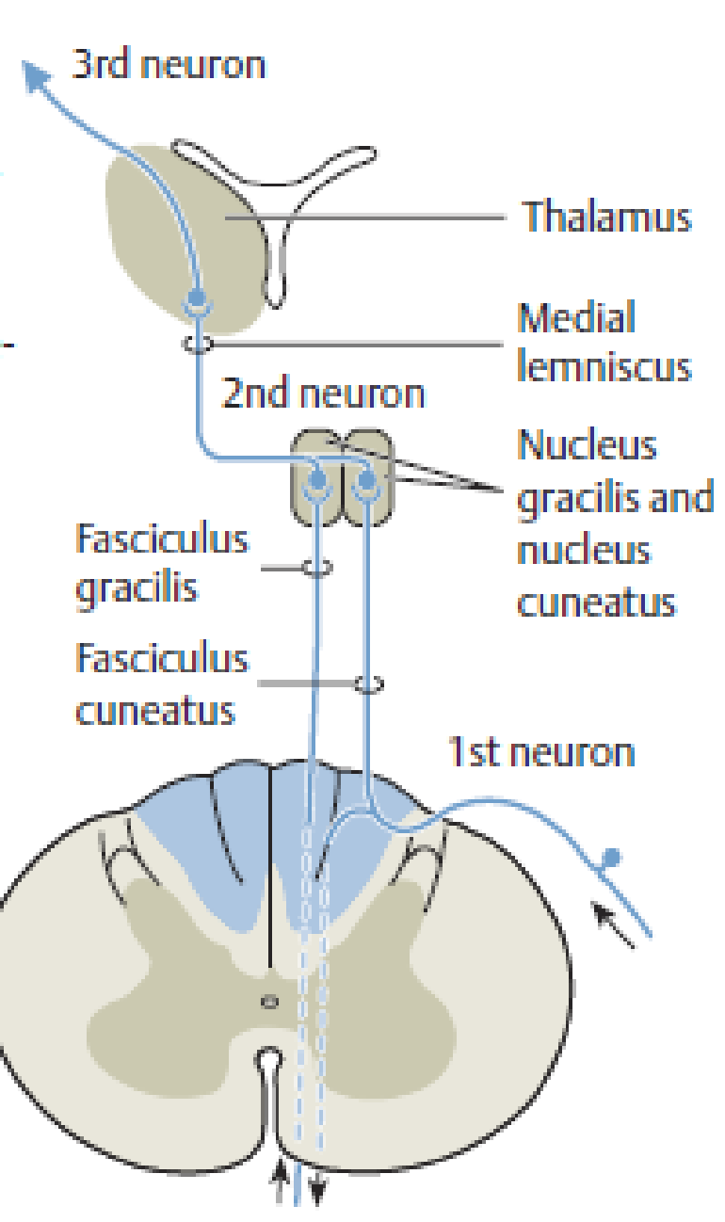
Posterior column pathway
Conscious proprioception – feeling of the position of the limbs, tension of the muscles, motion of the joints
The fibres ascends the spinal cord ipsilaterally to the second neuron nucleus gracilis and cuneatus
The axons of the 2nd neuron travel to thalamus, 3rd neuron

Slide 36
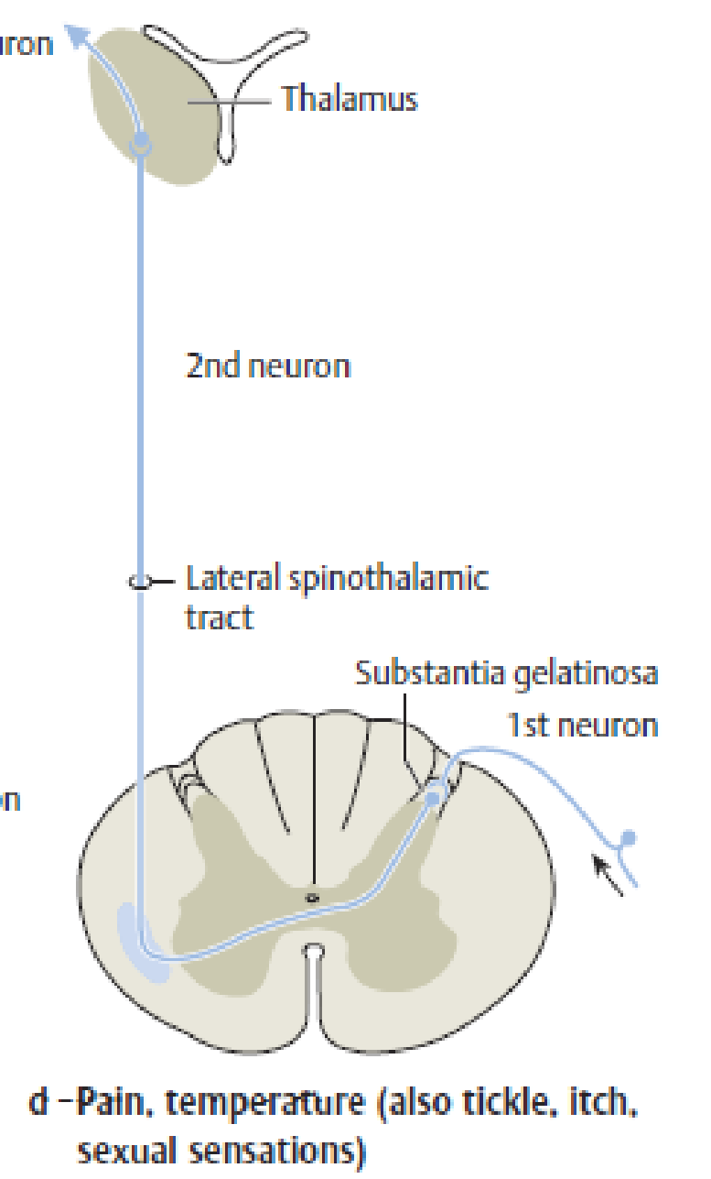
Spinothalamic pathway
3rd neuron
Anterior spinothalamic tract
info from the nerve endings of the hair follicules, tactile corpuscles via the spinal root ganglion to the dorsal root ganglion, 2nd neuron
Making synapic contact at various segmental levels in the posterior horn
Fibres cross in the anterior spinal commissure, ascend in the contralateral anterolateral tract to thalamus
Lateral spinothalamic tract
Info from free nerve endings of pain, thermal stiimuli
Short collaterals within one or two segments in the substantia gelatinosa after that cross the midline and travel contralateral lateral funiculus to thalamus

Slide 37
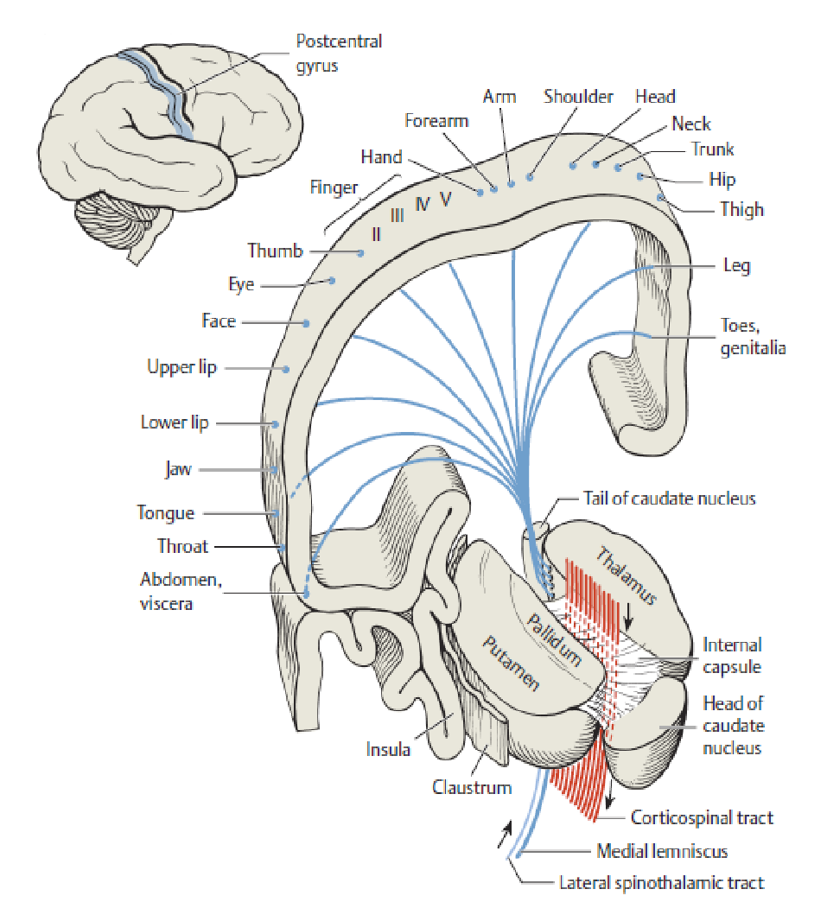
Central connection between thalamus and sensory cortex
Thalamus, where is the 3rd neuron, send their axons through the internal capsule to the primary somatosensory cortex in the postcentral gyrus
The different sensory modalities are spatially segregated in thalamus
Conscious differentiation of stimuli requires the participation of the cerebral cortex
Notes:
Postcentral gyrus – cytoarchitectural areas 3a, 3b, 2, and 1 – here meediate superficial sensation, touch, pressure, pain, temperatuure, partly propioception. –
Some sensory afferent fibres terminate in primary motor cortex of the precentral gyrus
Thus some sensory and motor fields overlap. This integration enables incoming sensory information immediately convert to outging motor impulses.
The descending pyramidal fibres emerging from these circuits terminate directly without interventing interneurons – to the anterior horn.

Slide 38
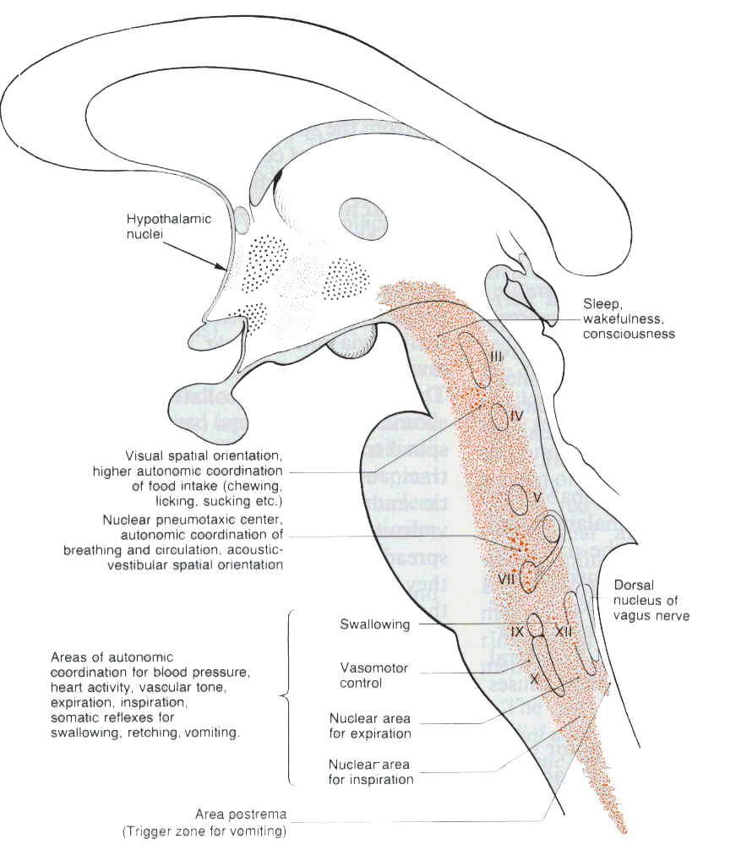
Reticular formation
Autonomic coordination
Somatic swallowing
Emotions, dryness of mouth
Blood pressure, cardiac function, vasocontriction and –dilatation
Inspiration, expiration
Auditory and vestibular spatial orientation
Autonomic coordination of food intake (sucking, chewing, ..)
Vomiting reflex

Slide 39
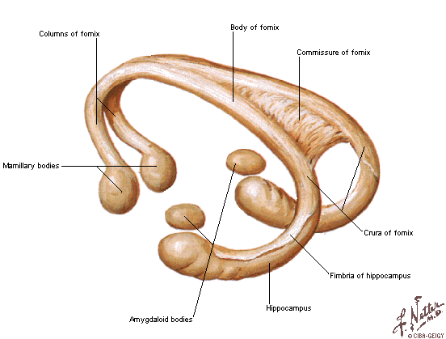
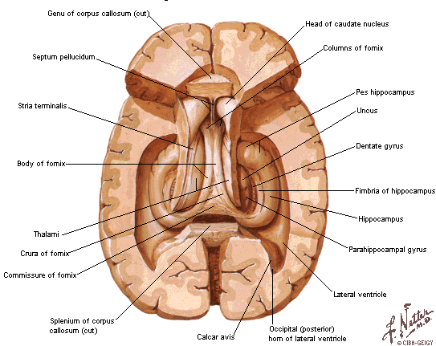
Limbic system
Connected with somatic and autonomic systems
Formation of components of emotions
Learning and memory
Motivational behaviours
Eating
Sexual behaviours
Systemic regulations
Sleep and wake cycle
Concentration and orienting
Emotions
Memory

Slide 40
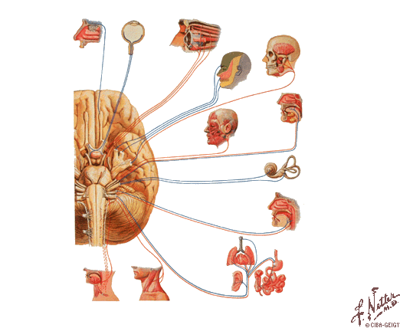
Cranial nerves
I - n. olfactorius, olfactory nerve
II - n. opticus, optic nerve
III - n. oculomotorius, oculomotor nerve
IV - n. trochlearis, trochlear nerve
V - n. trigeminus, trigeminal nerve
VI - n. abducens, abducens nerve
VII - n. facialis, facial nerve
VIII - n. vestibulocochlearis, vestibulocochlear nerve
IX - n. glossopharyngeus, glossopharyngeal nerve
X - n. vagus, vagus nerve
XI - n. accessorius, accessory nerve
XII - n. hypoglossus, hypoglossal nerve

Slide 41
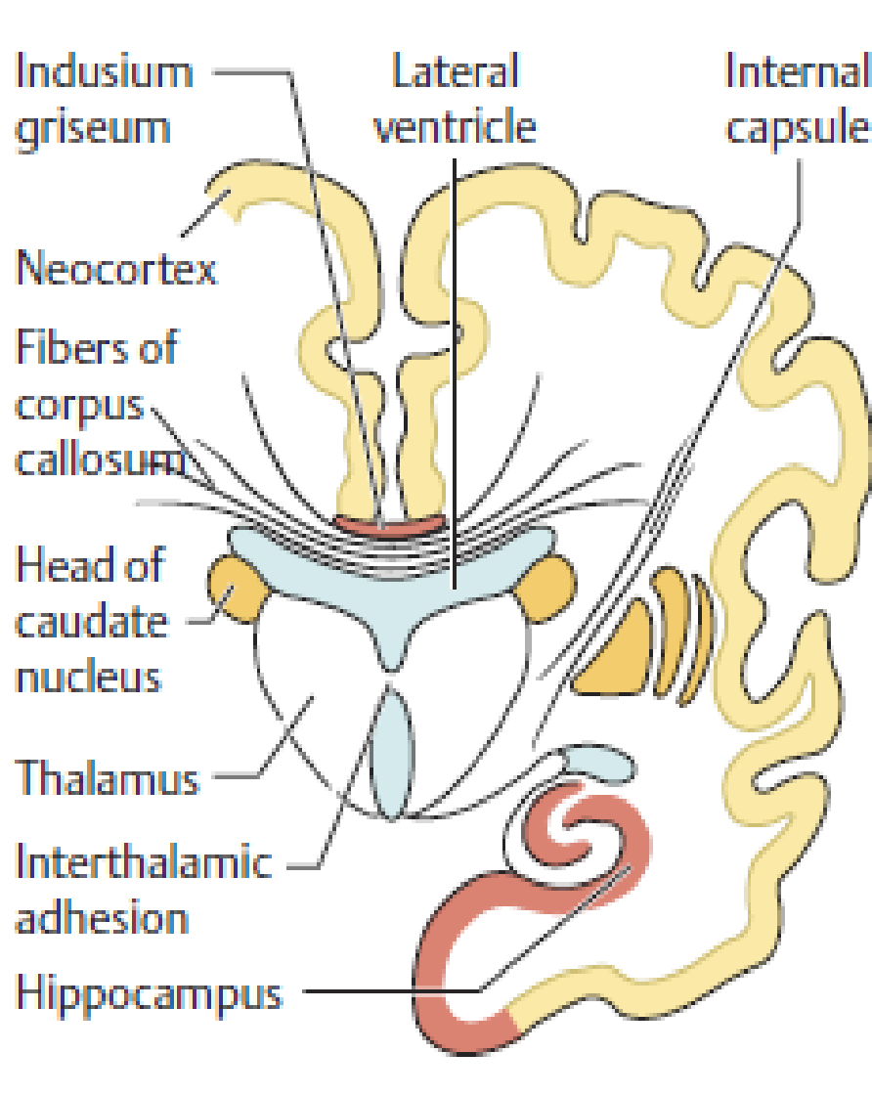
Cerebrum
Macroscopically, the cerebrum is made up of the cerebral cortex, the subcortical white matter, and the basal ganglia, which were discussed before
Histologically, most of the cerebral cortex possesses a six-layered cellular architecture, cytoarchitecturally distinct cortical areas.
Areas which are related spesific tasks named primary cortical fields, the greater part of the cerebral cortex consists of association areas, whose function apparently consists of higher-level processing of information derived from, or traveling to, the primary fields.
Higher cortical functions such as language, in particular, cannot be localized to a single cortical area but depend instead on a complex interaction of multiple areas.

Slide 42
Cortical functions
Cortical functions, particularly higher ones like language, cognition, and the control of specific patterns of behavior, cannot always be assigned to a single cortical location
Primary cortical fields have a receptive function: they are the final targets of the somatosensory and special sensory pathways (visual, auditory, etc.) in the CNS, and they receive their afferent input by way of a thalamic relay.
The primary cortical fields serve to bring the respective sensory qualities to consciousness in raw form, i.e., without interpretation
The primary somatosensory and motor fields of the neocortex contain somatotopic, form of a homunculus
The primary visual cortex is located in the depths of the calcarine sulcus and it extends only slightly beyond the occipital pole. The visual cortex of one side receives visual information from the temporal half of the ipsilateral retina and the nasal half of the contralateral retina.
The primary auditory cortex is located in the transverse gyri. the primary auditory cortex of each side processes impulses arising in both ears
Taste-related impulses are processed first in the rostral nucleus of the tractus solitarius in the brainstem and then conducted tegmental tract, to a relay station in the ventral posteromedial nucleus of the thalamus (parvocellular part). They then travel onward through the posterior limb of the internal capsule to the primary gustatory cortex, to frontal gyrus, ventral to the somatosensory cortex
Vestibular impulses from vestibular nucleid are conducted from thalamus to postcentral gyrus

Slide 43
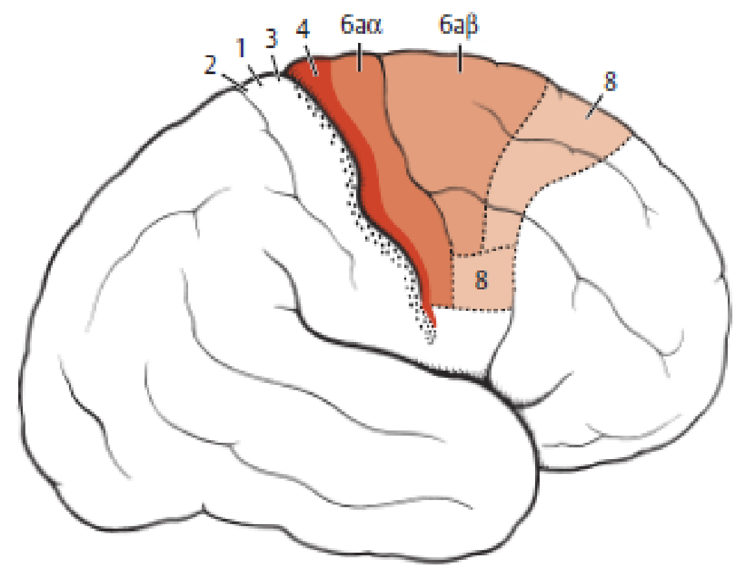
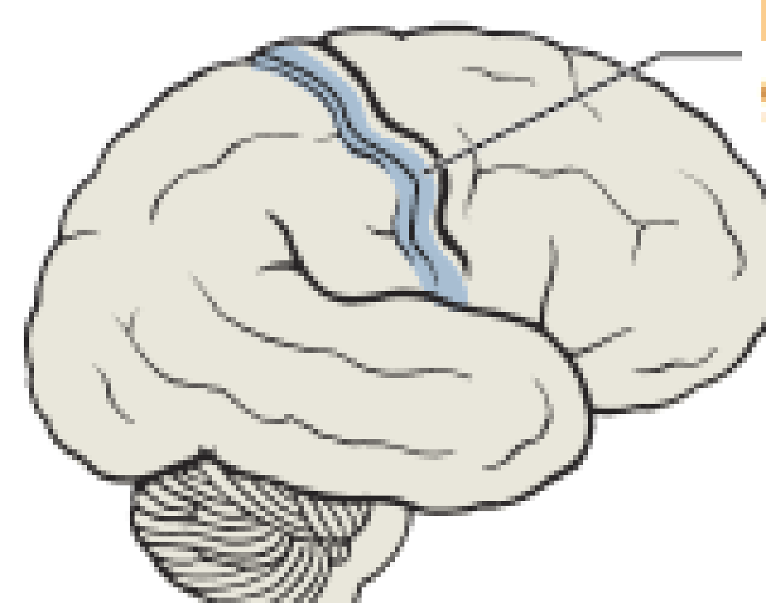
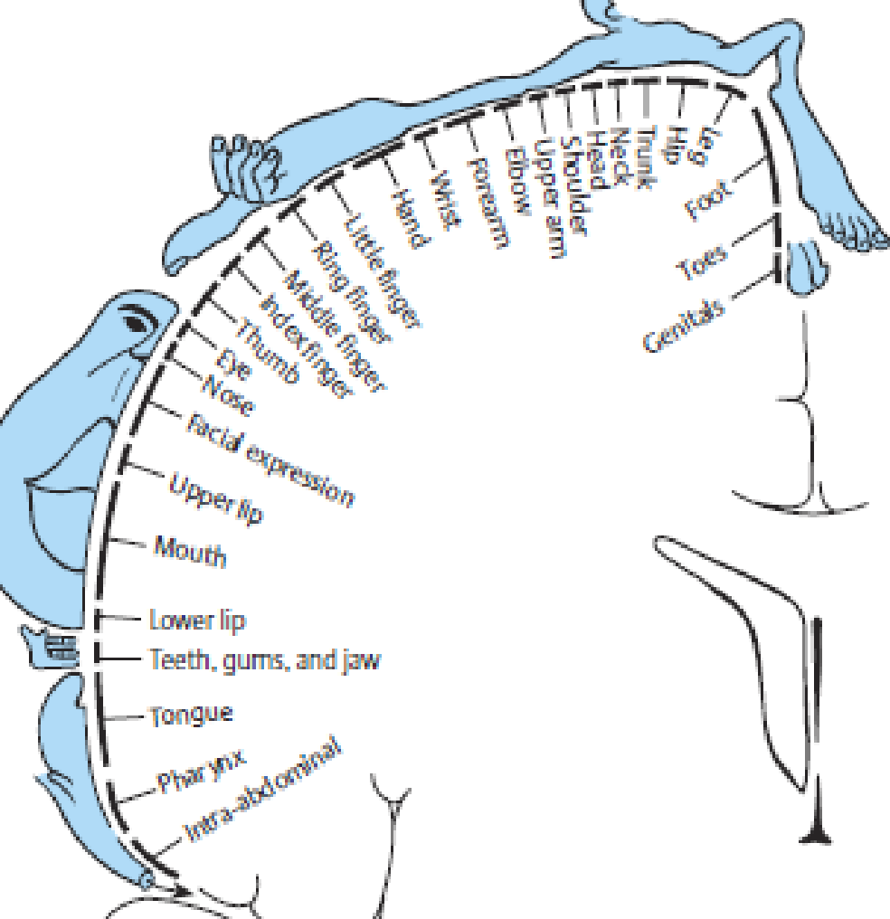
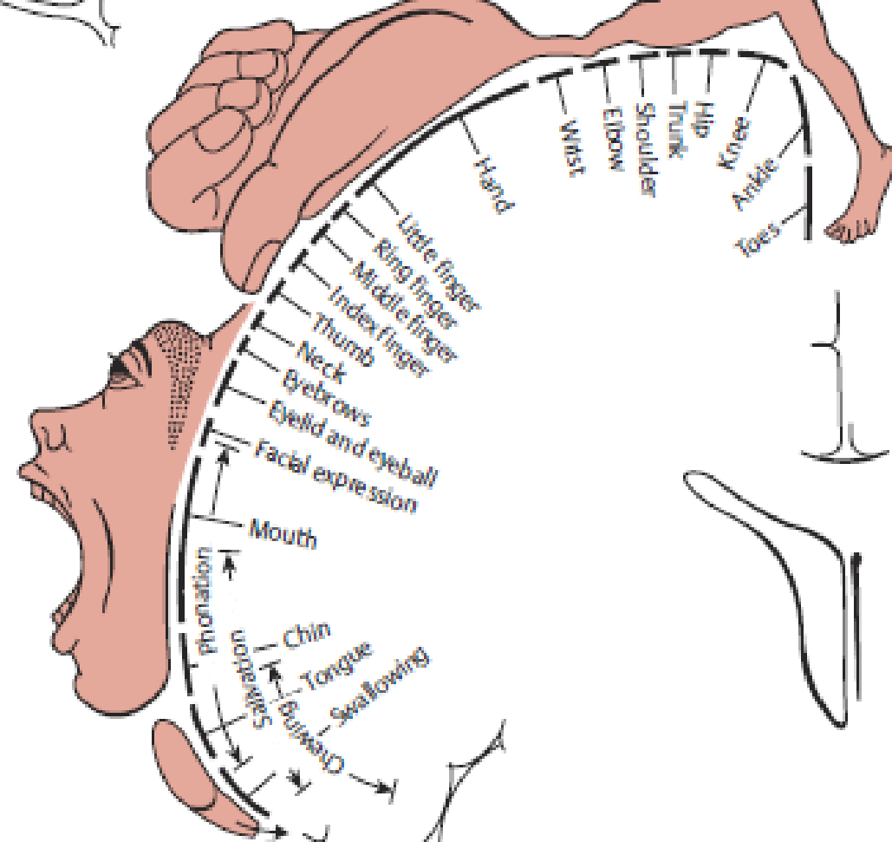
Human primary somatosensory and motor fields

Slide 44
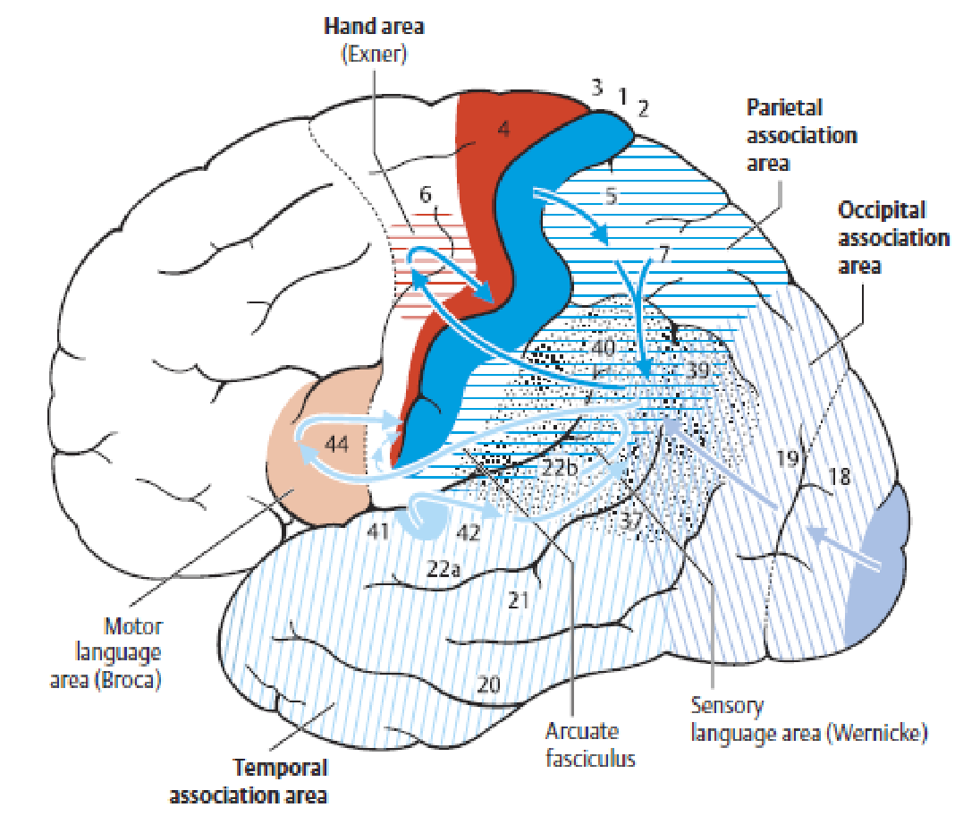
Multimodal association fields
multimodal association areas not tightly linked to any single primary cortical field
They make afferent and efferent connections with many different areas of the brain
The largest multimodal association area is the multimodal portion of the frontal lobe, 20% of the entire neocortex
Another important multimodal association area is found in the posterior portion of the parietal lobe (1,2,3,5)

Slide 45
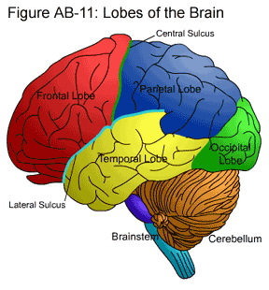
Frontal lobe
The primary motor cortex (area 4, p. 372), which has already been described, the premotor cortex (area 6, see below), and the prefrontal region, a large expanse of cortex consisting of multimodal association areas
The planning, initiation, cntrol of movements
The prefrontal cortex is primarly concerned with cognitive tasks and control behavior
Lateralization – dominant lobe control language - Broca’s area

Slide 46
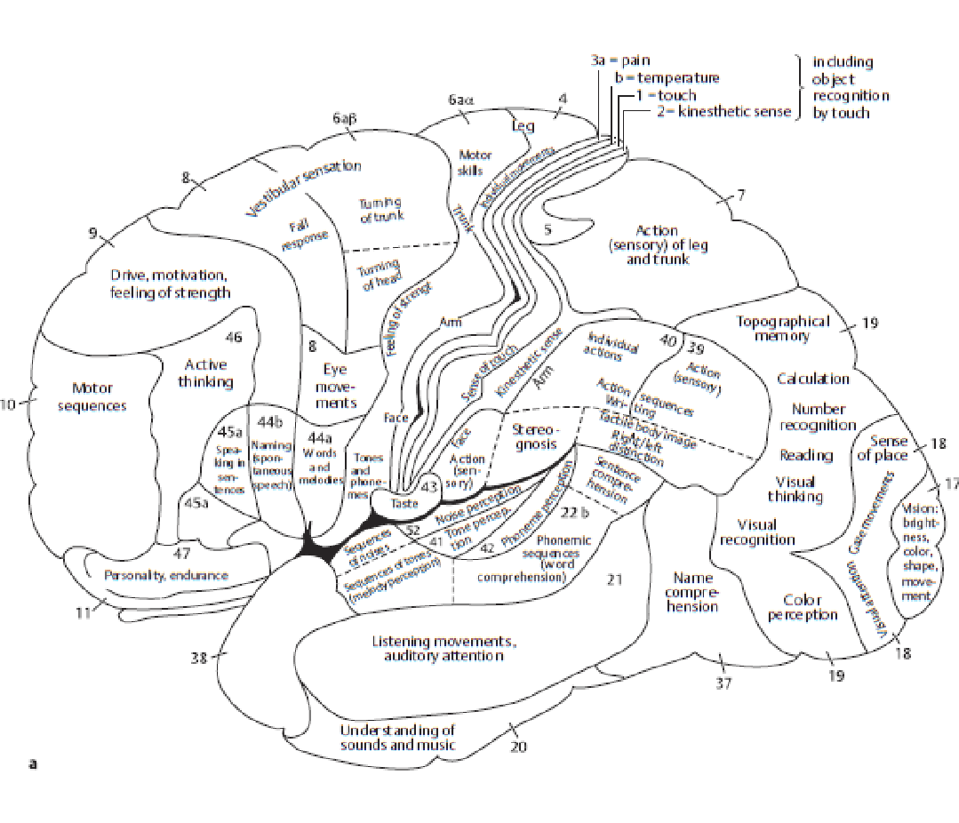
Temporal lobe
Dominant hemisphere, Wernicke’s area, primarily concerned with the analysis of heard sounds that are classified as words, to understanding language and learning and remembering verbal information
Non-dominant lobe, which is typically the right temporal lobe, is involved in learning and remembering non-verbal information (e.g. visuo-spatial material and music).
Processing auditory, affect/emotions, language, and certain aspects of visual perception
Notes:
Damage to the temporal lobes can result in:
Difficulty in understanding spoken words (Receptive Aphasia)
Disturbance with selective attention to what we see and hear
Difficulty with identification and categorisation of objects
Difficulty learning and retaining new information
Impaired factual and long-term memory
Persistent talking
Difficulty in recognising faces (Prosopagnosia)
Increased or decreased interest in sexual behaviour
Emotional disturbance (e.g. Aggressive behaviour)

Slide 47
Parietal lobe
important for processing and interpreting somatosensory input
Integrate sensory input, and construction of a spatial coordinate system to represent the world around us.
Notes:
Damage to the Parietal lobes can result in:
Difficulty with drawing objects
Difficulty in distinguishing left from right
Spatial disorientation and navigation difficulties
Problems with reading (Alexia)
Inability to locate the words for writing (Agraphia)
Difficulty with doing mathematics (Dyscalculia)
Lack of awareness of certain body parts and/or surrounding space (Neglect)
Inability to focus visual attention
Difficulty with motor planning and complex movements(Apraxia)
Contralateral hemisensory loss
Astereognosis – inability to determine 3-D shape by touch.
Agraphaesthesia – inability to read numbers or letters drawn on hand, with eyes shut.
Contralateral homonymous inferior quadrantanopia
Asymmetry of optokinetic nystagmus (OKN)
Sensory seizures

Slide 48
Occipital lobe
responsible for visual perception, including colour, form and motion.
Notes:
Damage to the occipital lobe can include:
Difficulty with locating objects in environment
Difficulty with identifying colours (Colour Agnosia)
Production of hallucinations
Visual illusions - inaccurately seeing objects
Word blindness - inability to recognise words
Difficulty in recognizing drawn objects
Inability to recognize the movement of an object (Movement Agnosia)
Difficulties with reading and writing

Slide 49
Sources
Beahr M, Frotscher M. Duus Topical Diagnosis in Neurology. Thieme 2005

